Slide 1
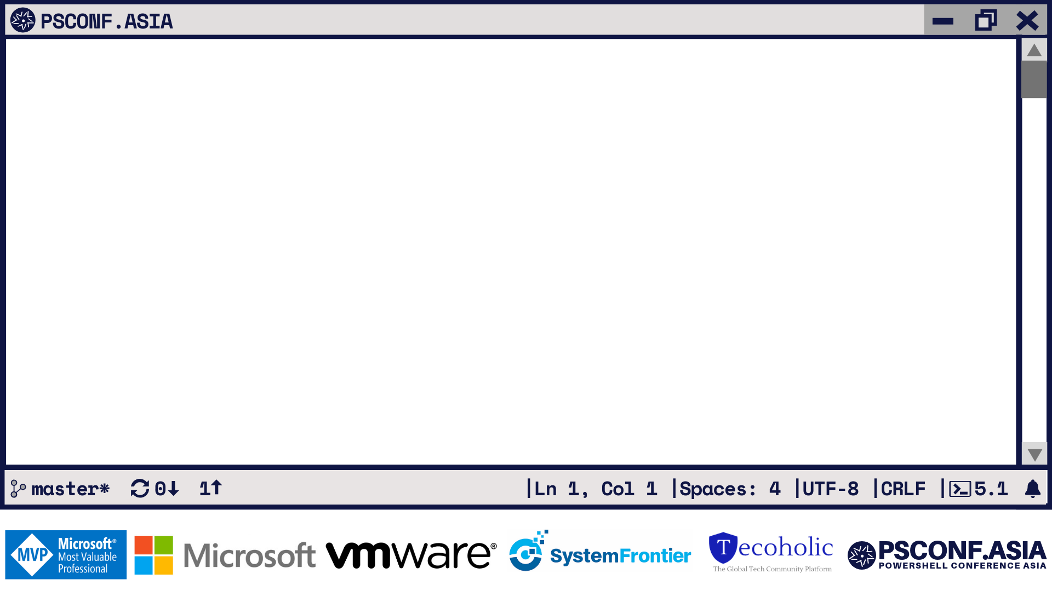
Deep Web
Web Cmdlets Deep Dive
Mark Kraus
Staff Systems Engineer, LinkedIn

Slide 2
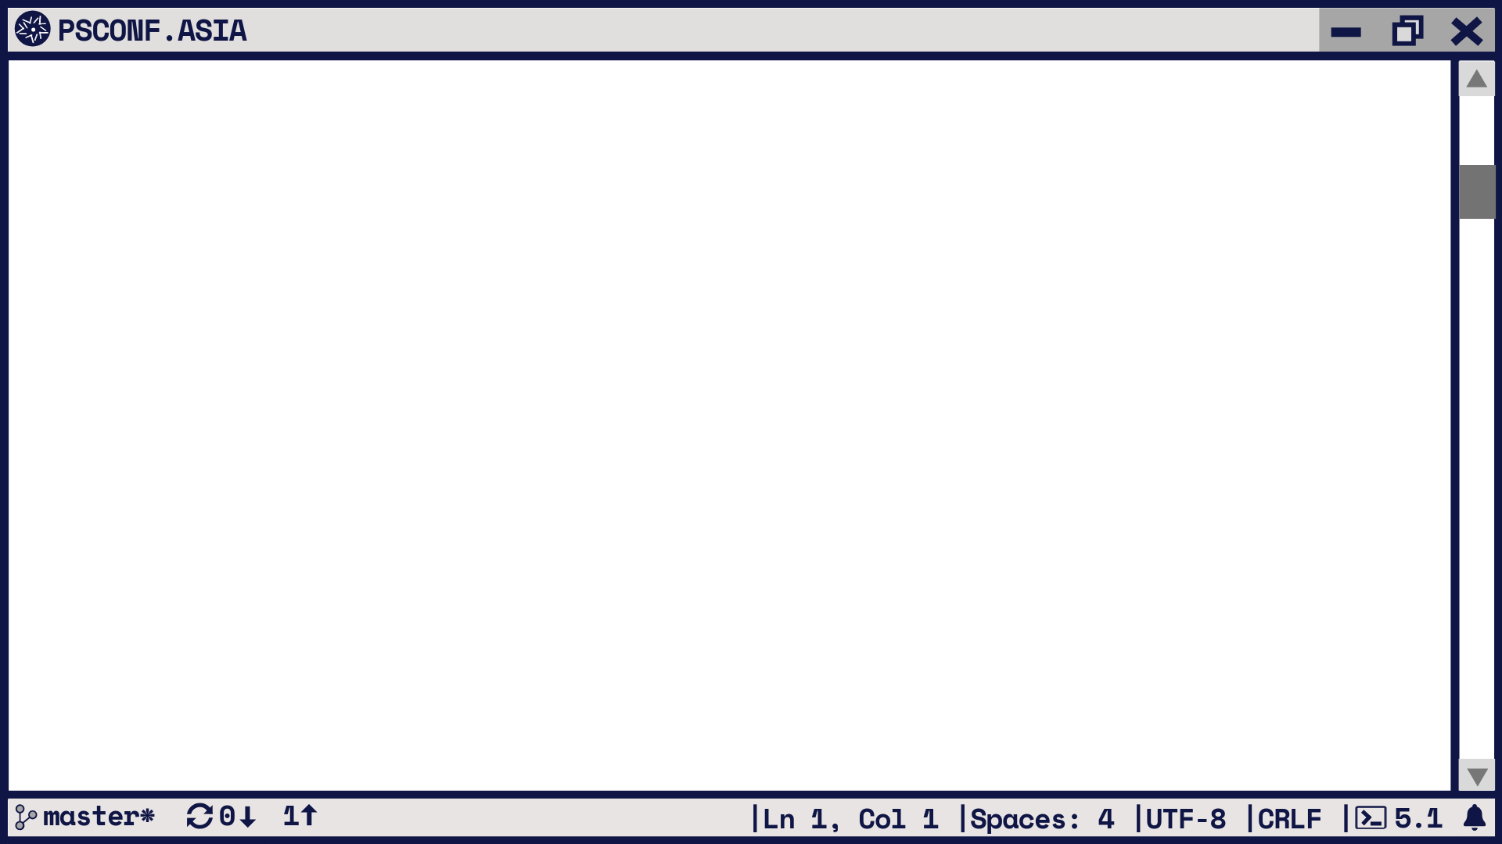

Why Web Cmdlets?
IT has changed
REST rules the world
Clouds run on REST
PaaS and Serverless run on REST
Your thermostat runs on REST

Slide 3
WebListener and Web Cmdlet Testing
WebListener is an ASP.NET Core Kestrel Server
In-CI cross-platform testing
200+ Pester tests for Web Cmdlets
Used in demos

Slide 4
Start WebListener
Start-WebListener.ps1

Slide 5

5.1 and 6.0 Differences
No Internet Explorer integration
Basic HTML Parsing Only
No ParsedHtml property
HTTP and HTTPS only
  No file:// or ftp:// support
No SSL 3.0 support

Slide 6
Basic Parsing Only Demo
01-BasicParsingOnly.ps1

Slide 7

HTTPS and Certificate Validation
6+ No ServicePointManager
6+ -SkipCertificateCheck
5 requires ServerCertificateValidationCallback
5 requires TLS 1.2 enabled
6+ Supports TLS 1.2 by default
6+ no custom certificate validation

Slide 8
HTTPS Demos
02-ServicePointManager.ps1
03-SkipCertificateCheck.ps1
04-TLS-1.2.ps1

Slide 9
Invoke-WebRequest Response Differences
6+ Header Values are arrays
5 BaseResponse property is [HttpWebResponse]
6+ BaseResponse property is [HttpResponseMessage]

Slide 10
Invoke-RestMethod Response Headers
-ResponseHeadersVariable parameter
Creates variable
Same object as Headers property on Invoke-WebRequest

Slide 11
Header Values Demo
05-HeaderValues.ps1

Slide 12
Authentication
-Authentication added in 6.0.0
  None – Default
  Basic – Requires -Credential
  OAuth – Requires -Token
Authentication over non-HTTPS not allowed by default
Use –AllowUnencryptedAuthentication to bypass

Slide 13
Authentication Demos
07-BasicAuth.ps1
08-OAuth.ps1

Slide 14
Web Cmdlet Internals
HttpClient and HttpClientHandler APIs
WebRequestPSCmdlet Base Class
Invoke-RestMethod: InvokeRestMethodCommand derived class
Invoke-WebRequest: InvokeWebRequestCommand derived class

Slide 15
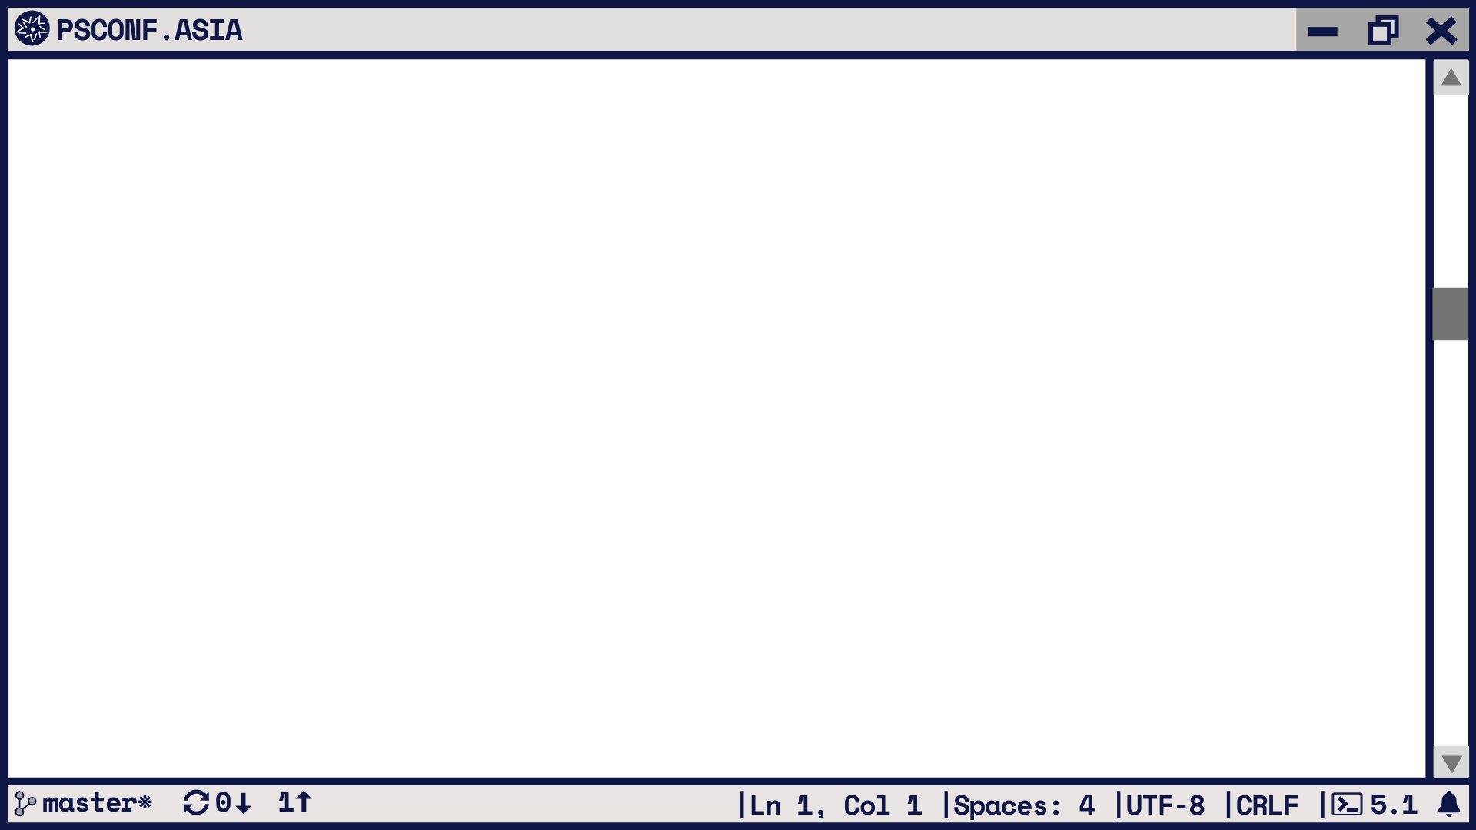
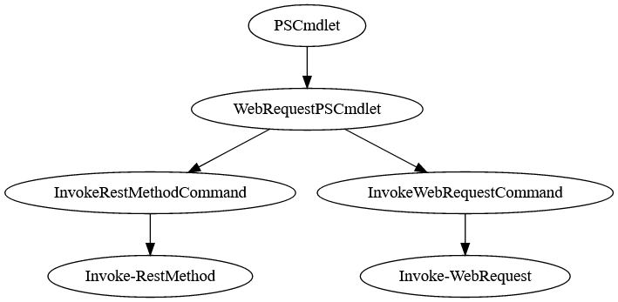

Slide 16
WebRequestPSCmdlet
ProcessRecord() for both cmdlets
Order of Operations:
  Validate Params
  Prepare Session
  Process Authentication Settings
  Create HttpRequestMessage
  Set Body Contents
  Check for success
  Create errors (if not successful)
  ProcessResponse()
  Retry or follow links

Slide 18
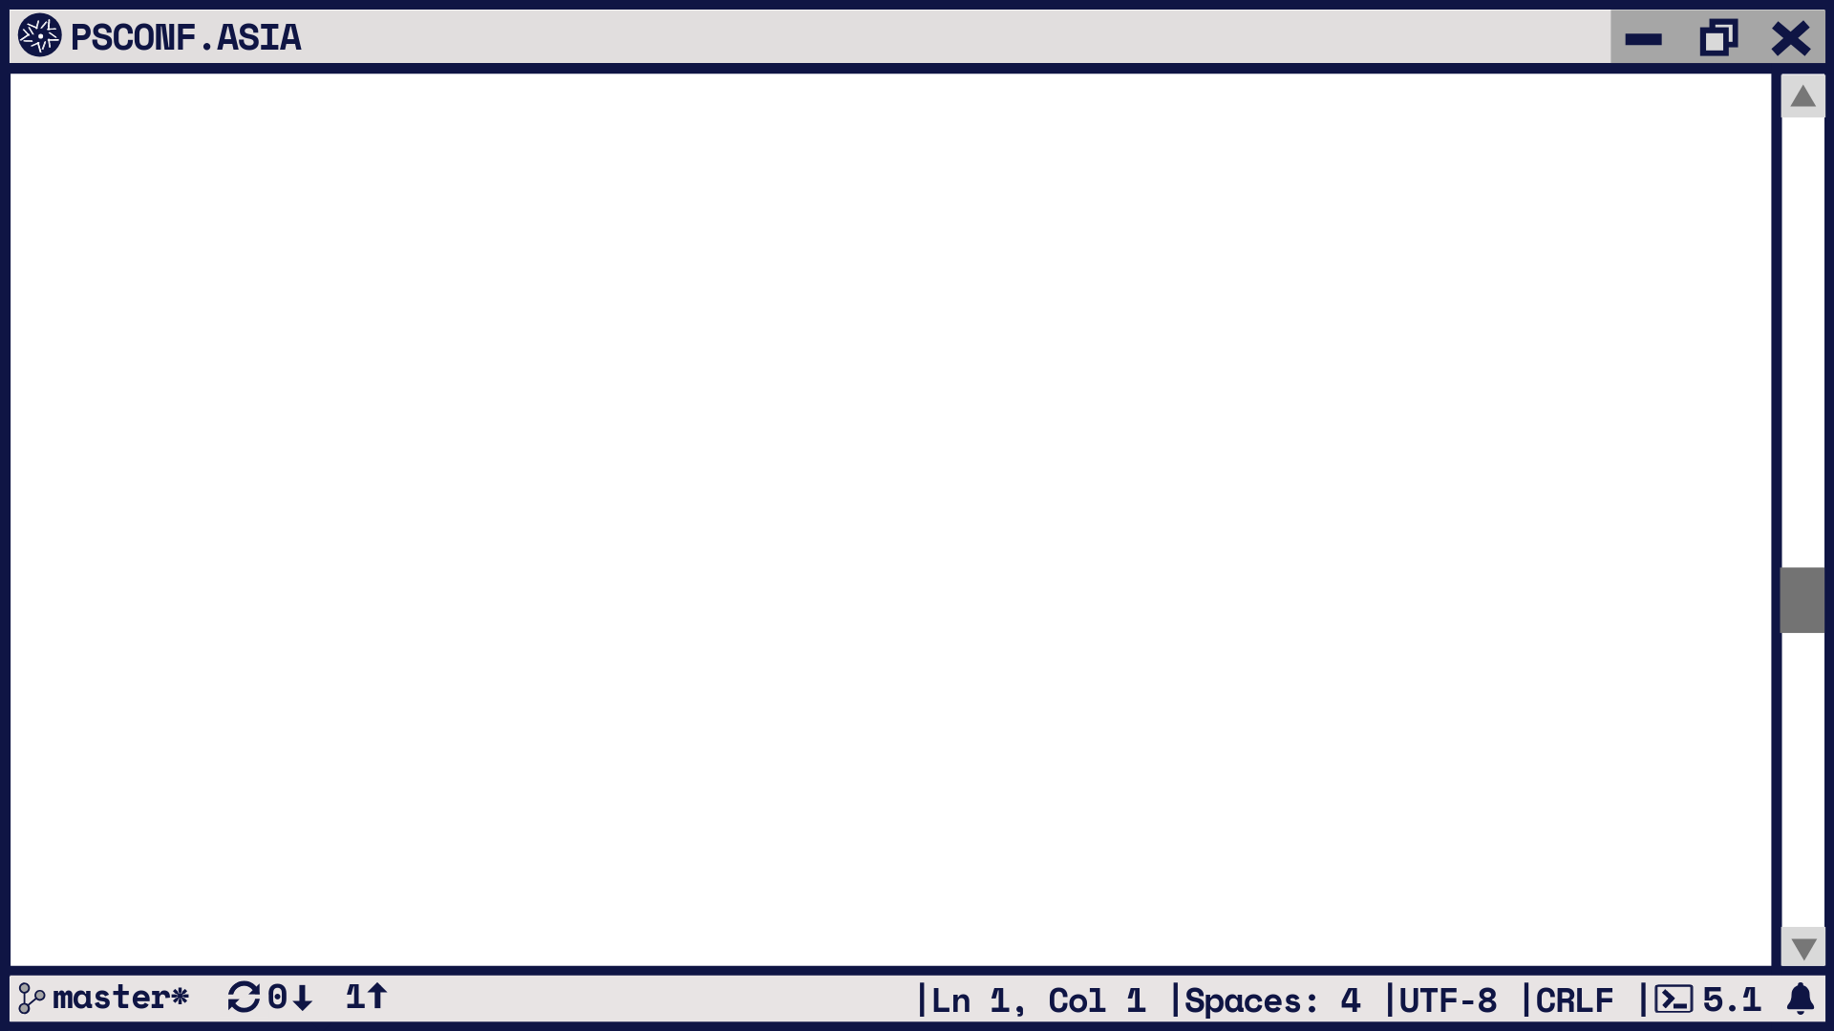
Invoke-WebRequest
If text response:
  Attempts Basic HTML Parsing
  Returns BasicHtmlWebResponseObject
If not text (image, binary, etc)
  Returns WebResponseObject
Writes to a file if -OutFile specified

Slide 19
Invoke-WebRequest Internals
WebRequestPSCmdlet.ProcessRecord()
InvokeWebRequestCommand.ProcessResponse()
StreamHelper.GetResponseStream()
WebResponseContentMemoryStream
WebResponseObjectFactory.GetResponseObject()
StreamHelper.SaveStreamToFile()

Slide 20
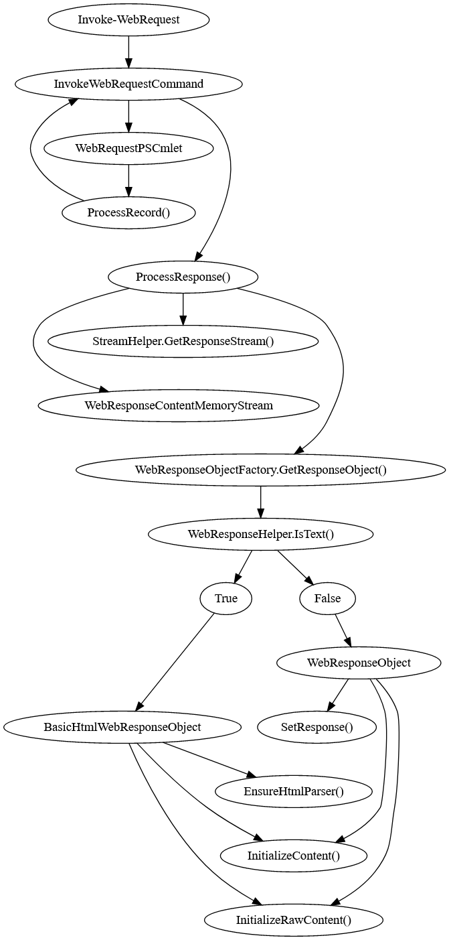

Slide 21
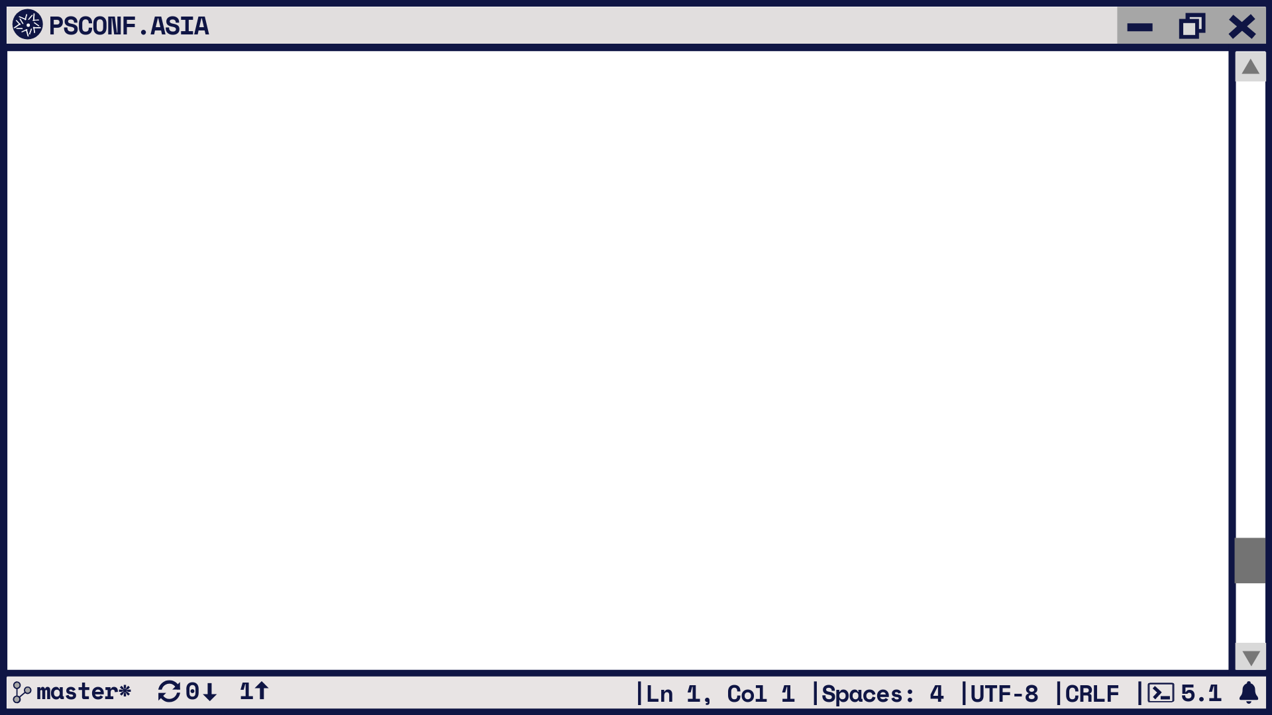
Invoke-RestMethod
Tries to parse as Atom/RSS
Tries to parse as JSON
Tries to parse as XML
Returns a string if all else fails.
Writes to a file if -OutFile specified

Slide 22
Invoke-RestMethod Internals
WebRequestPSCmdlet.ProcessRecord()
InvokeRestMethodCommand.ProcessResponse()
TryProcessFeedStream()
StreamHelper.GetResponseStream()
CheckReturnType()
StreamHelper.TryGetEncoding()
StreamHelper.DecodeStream()
TryConvertToJson()
TryConvertToXml()

Slide 23
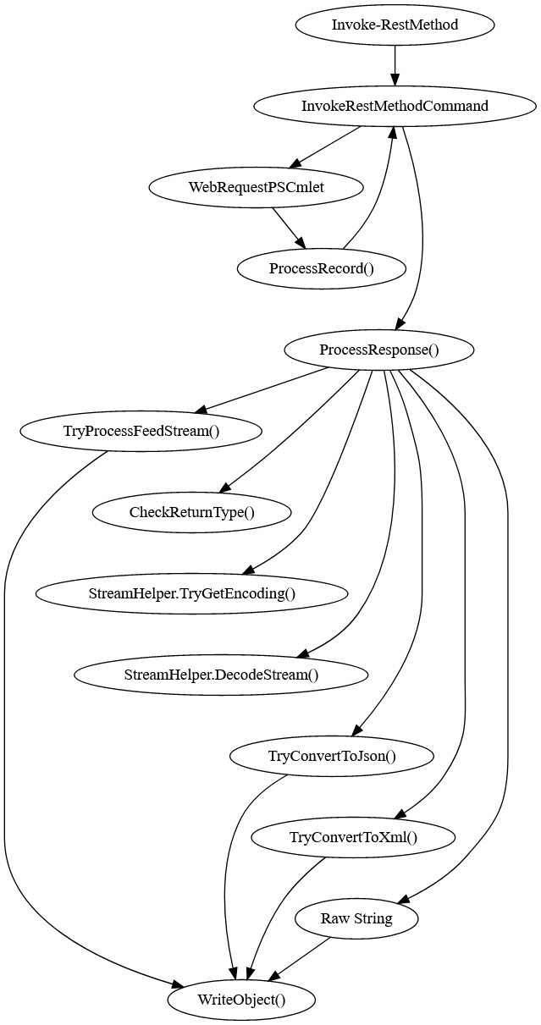

Slide 24
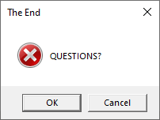

Twitter: @markekraus
GitHub: markekraus
aka.ms/PSDiscord: markekraus
Twitch: markekraus
linkedin.com/in/markekraus/
Get-PowerShellBlog.blogspot.com
Please Rate Sessions on eventRaft

Slide 25
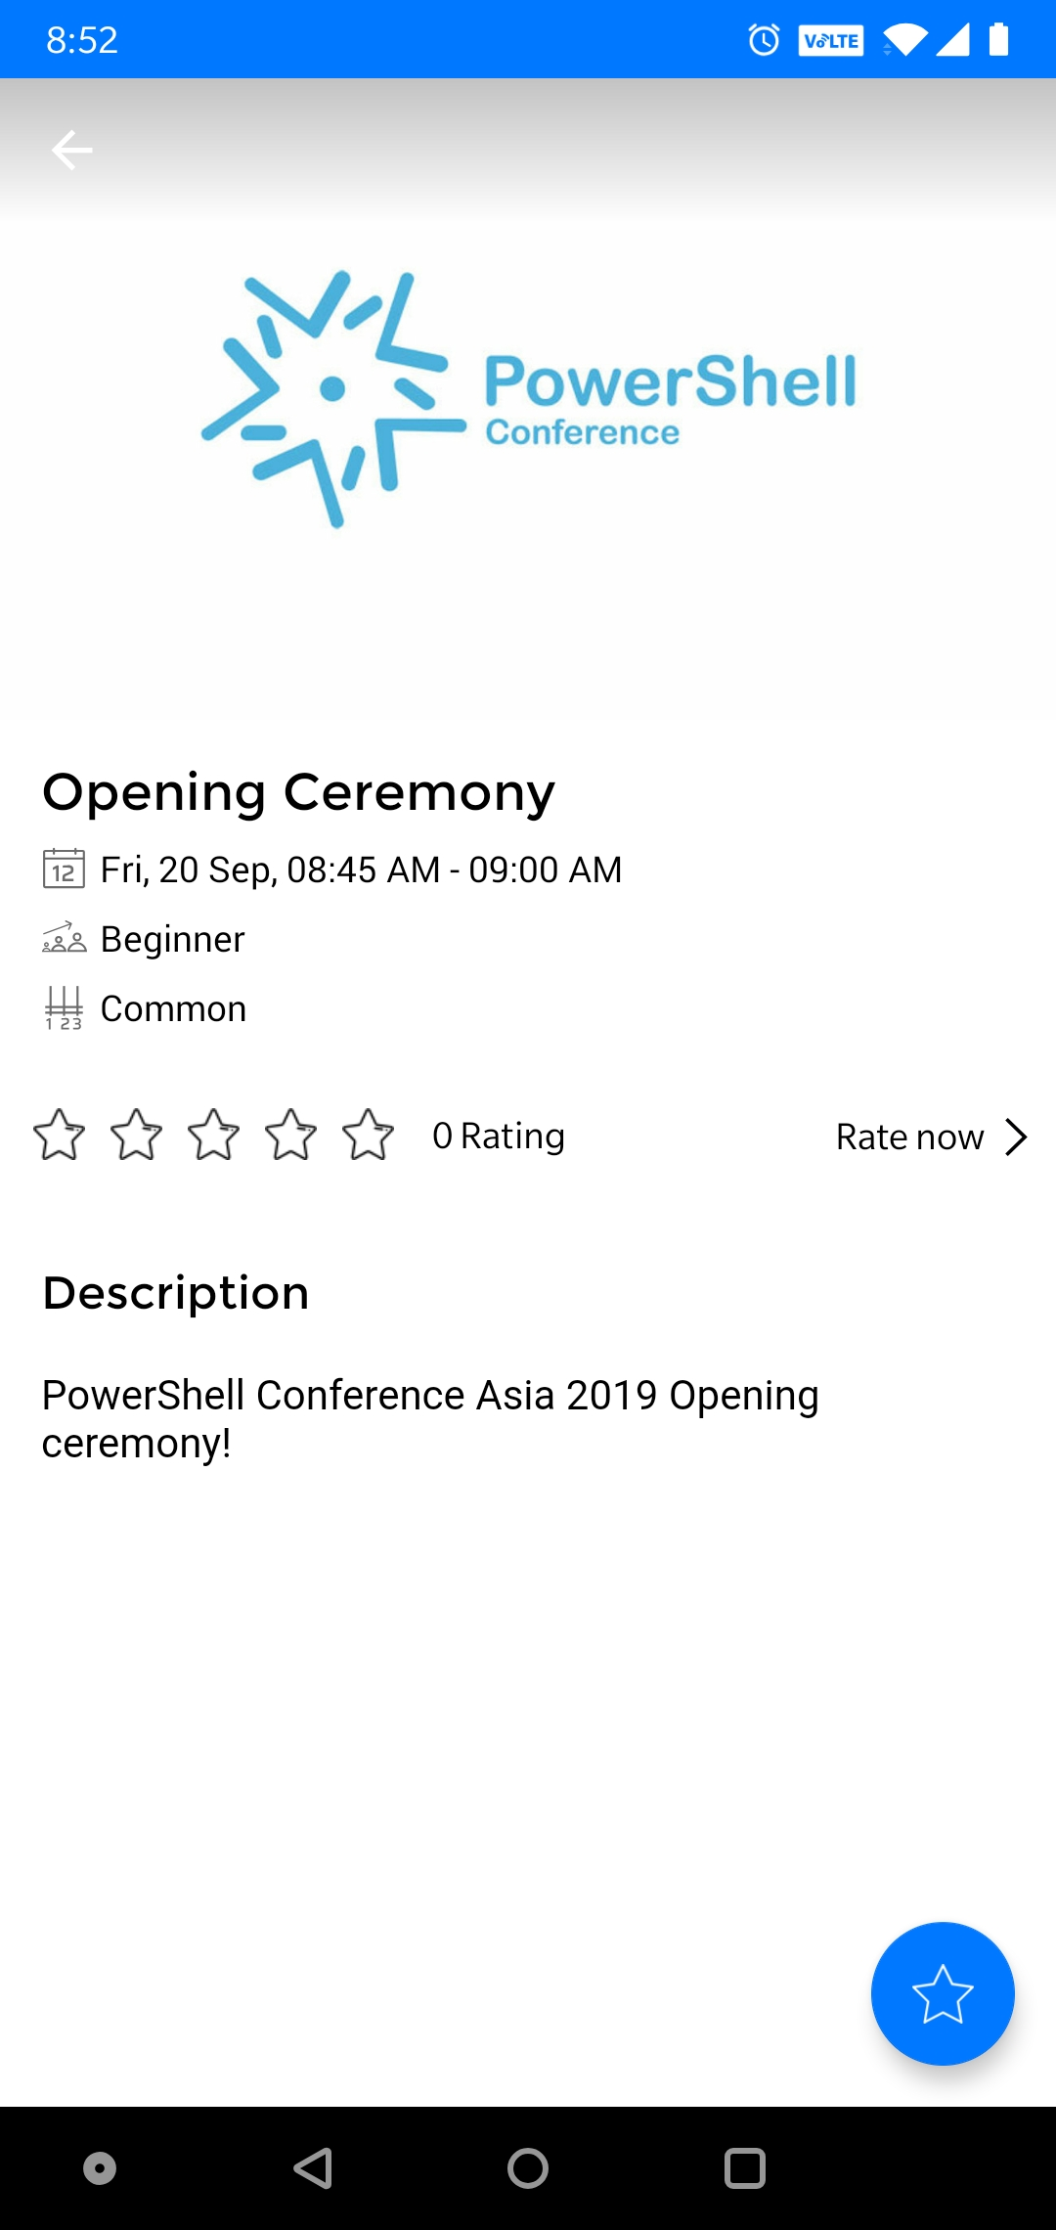
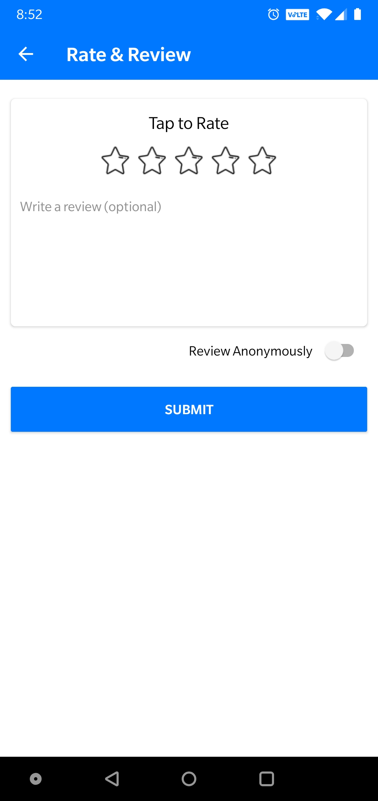

DO NOT Forget to rate the sessions!
https://my.eventraft.com/psconfasia19

